Slide 1

TAMUC AUTOMOBILES ERD With Visual Representations
An attempt to address the problem on Data-Drift.
By Team 3:
Ruthvik Rajan Banda
Rohit Bheemaraju
Tharun Kumar Vakada
Likitha Nachukuru
Sushmitha Seguri

Slide 2
focusing on the problems addressed by ceo
New latitude and longitude columns added to the customer address to allow for more effective truck routing will cause a data drift.
Zip codes stored in a numeric field can cause problems if the company starts selling overseas and the field now has to be alphanumeric.
Wants to check the current inventory level of each used car.
Each vehicle typically will be shipped from other manufacturers from multiple countries when the number of vehicles in inventory drops to a certain number.
For each car test when the customer has problems or questions, the salesperson wants to write down in a log.
The salesperson wants to keep track with the progress of all customers that they interact with.
Keeping track of sales and payments on sales.
Who purchased the car, the VIN number of the car, and the salesperson who sold the car.
For each transaction, information about the sale such as down payment, credit score, trade-in values are also entered in the system.
Trade In Details.

Slide 3
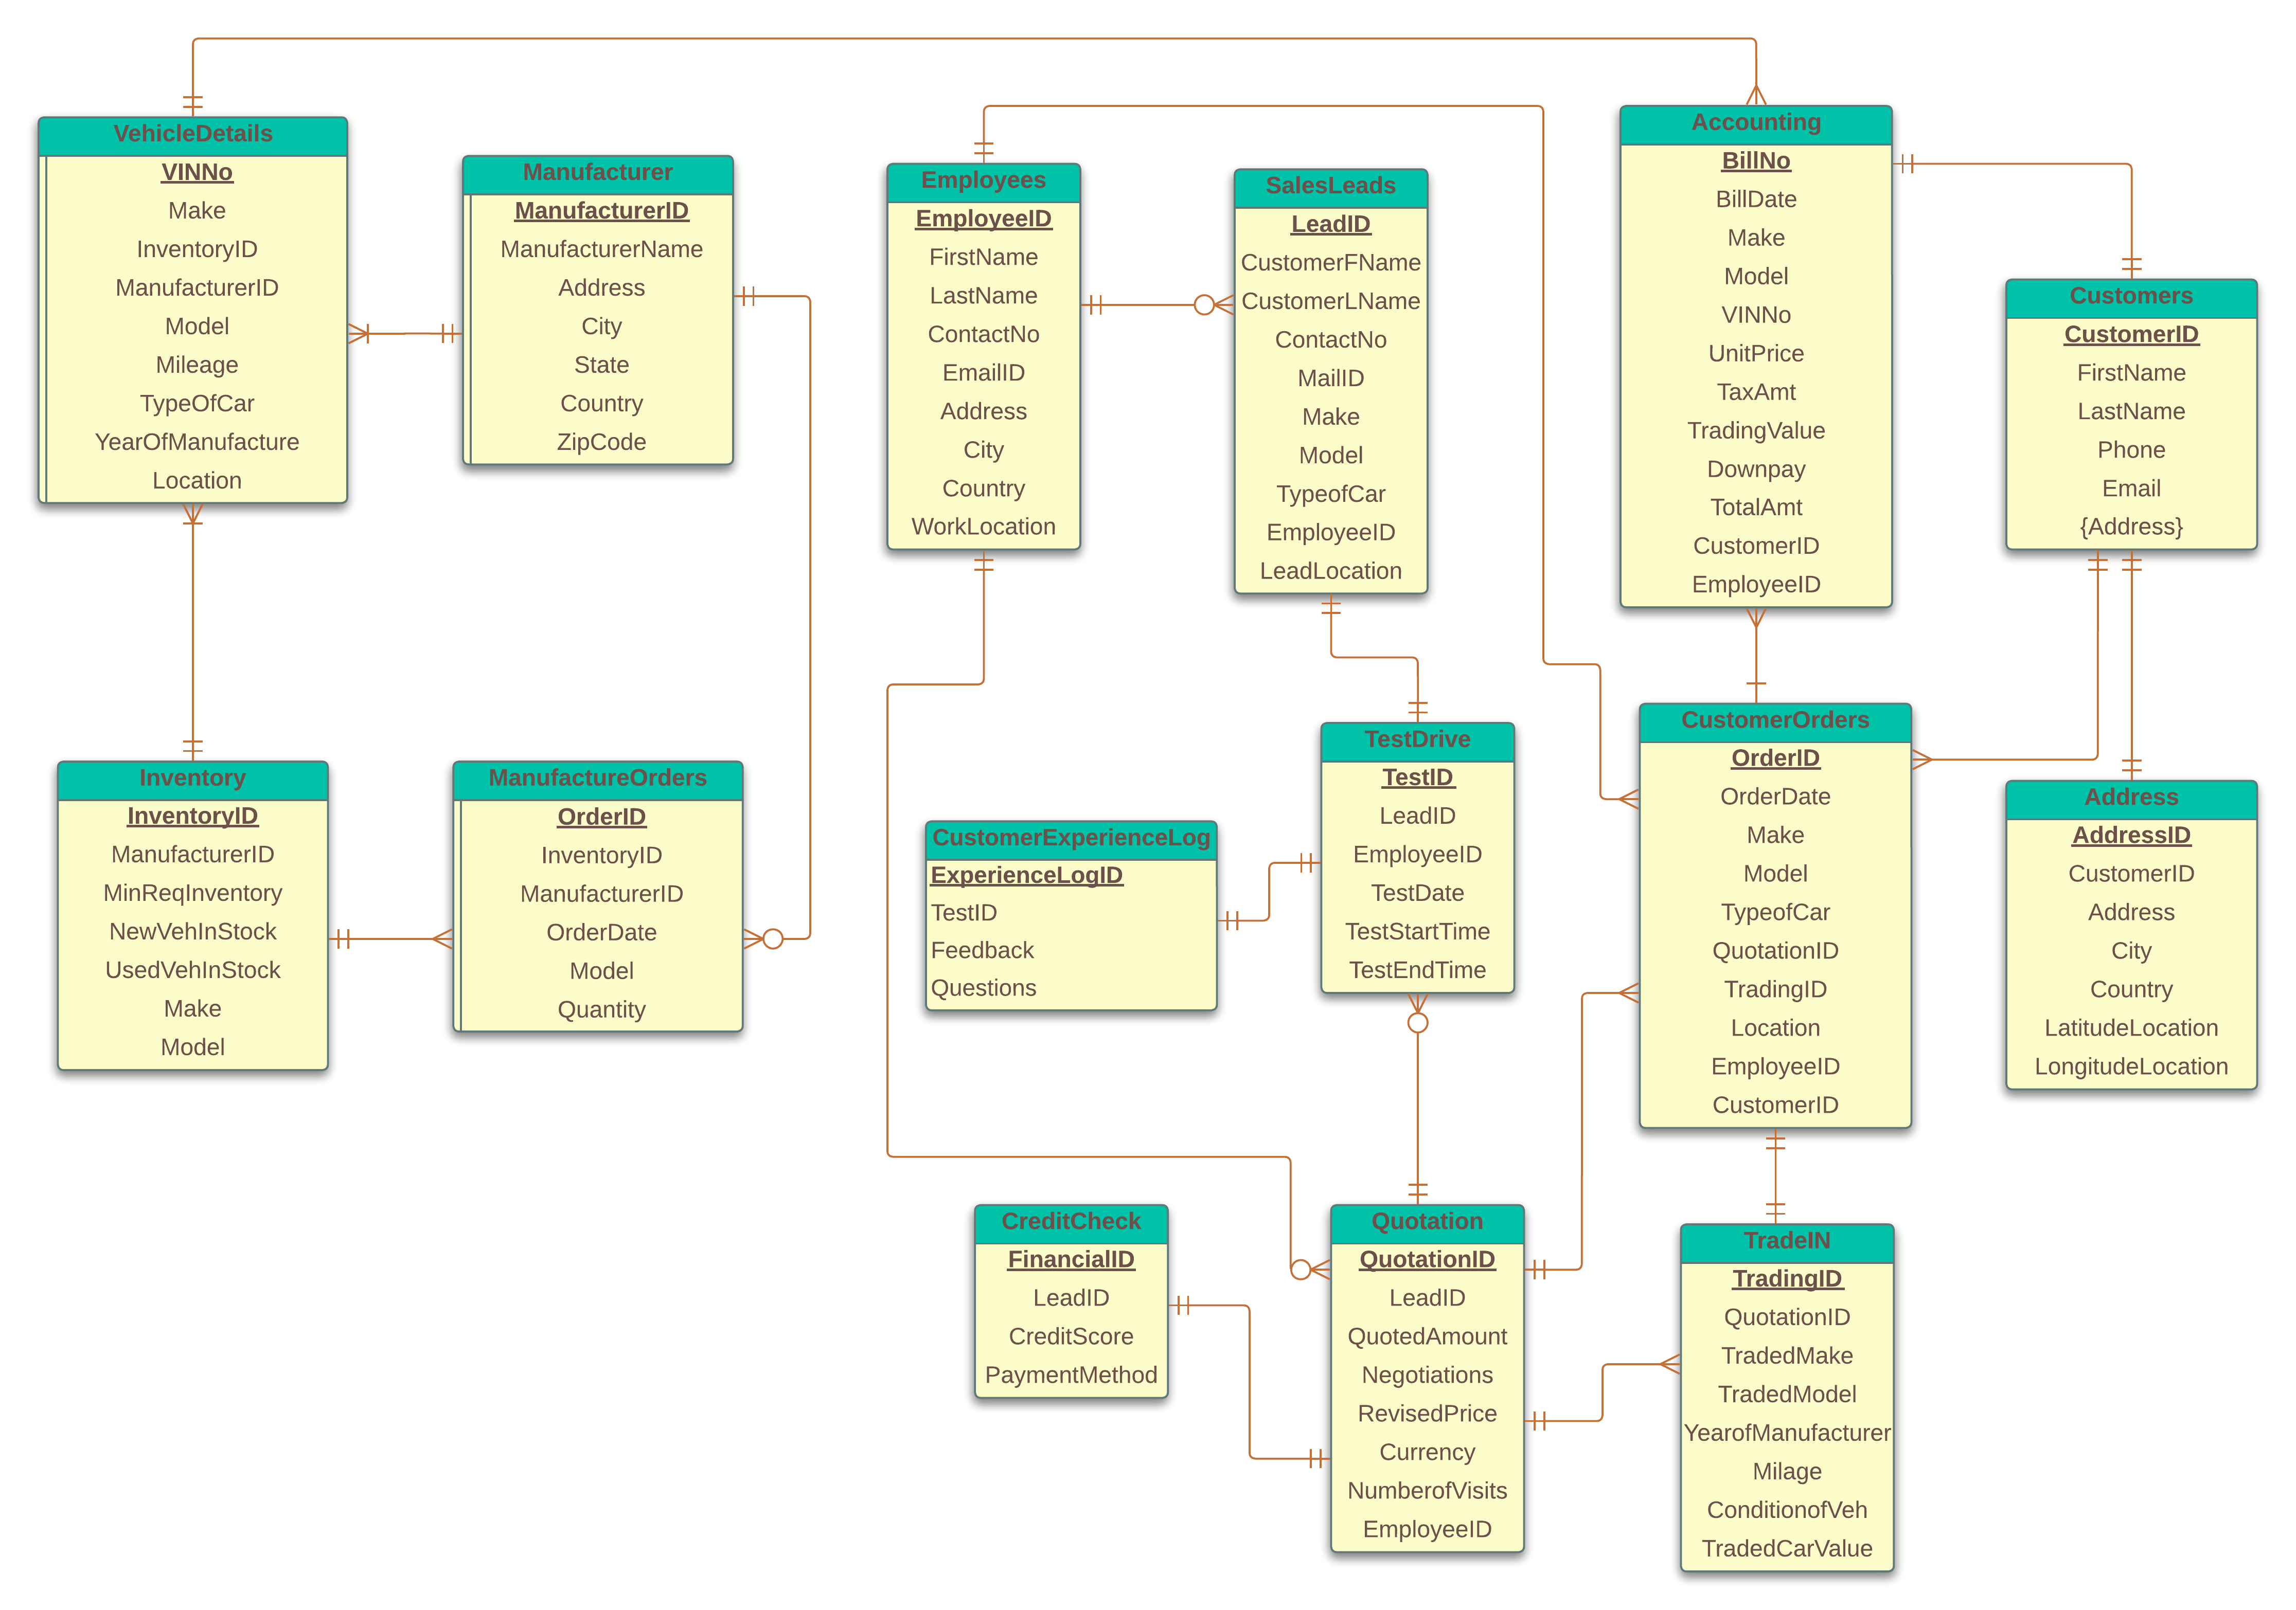
DATABASE MAP ON erd

Slide 4
ADDRESSING THE DATA DRIFT PROBLEM

Slide 5
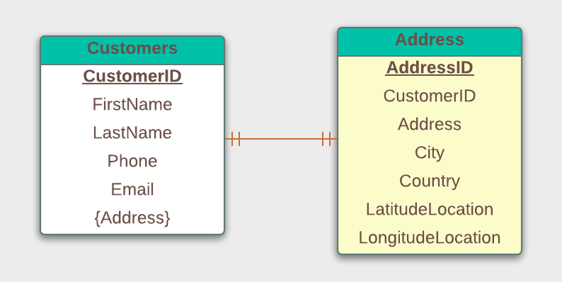
New latitude and longitude columns added to the customer address to allow for more effective truck routing will cause a data drift.

Slide 6
Zip codes stored in a numeric field can cause problems if the company starts selling overseas and the field now has to be alphanumeric.
ManufacturerName | ZipCode
GMC Ltd. | 75015
Ford Ltd. | 12548Z
Toyota Ltd. | K547545
Chrysler Ltd. | 587541
Honda Ltd. | 254875
Dodge | 487515

Slide 7
DATABASE APPLICATION TO SUPPORT COMPANY’S USERS WORK IN INVENTORY, CUSTOMER MANAGEMENT AND SALES.

Slide 8
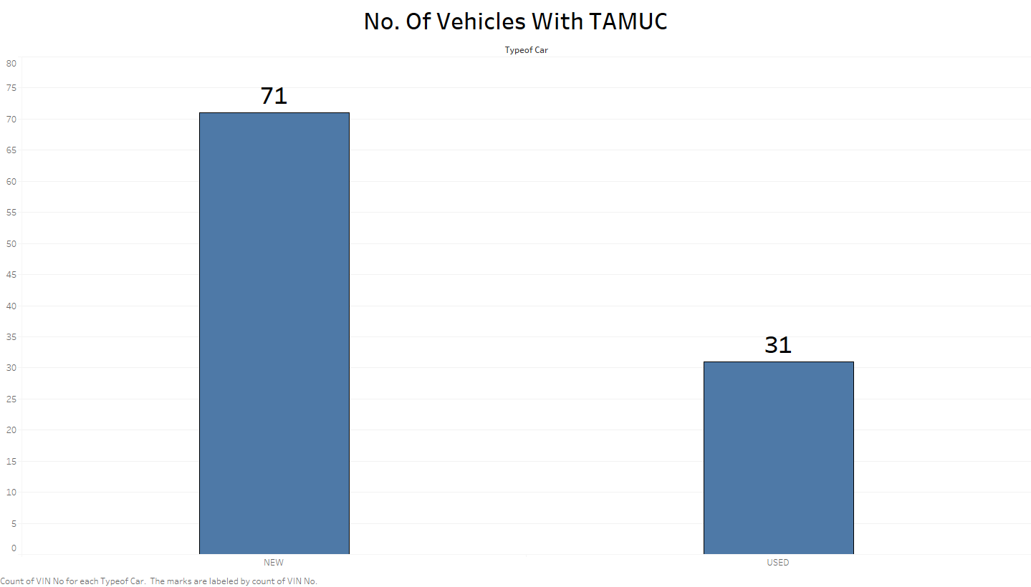
Wants to check the current overall level of inventory. (NEW and USED cars).

Slide 9
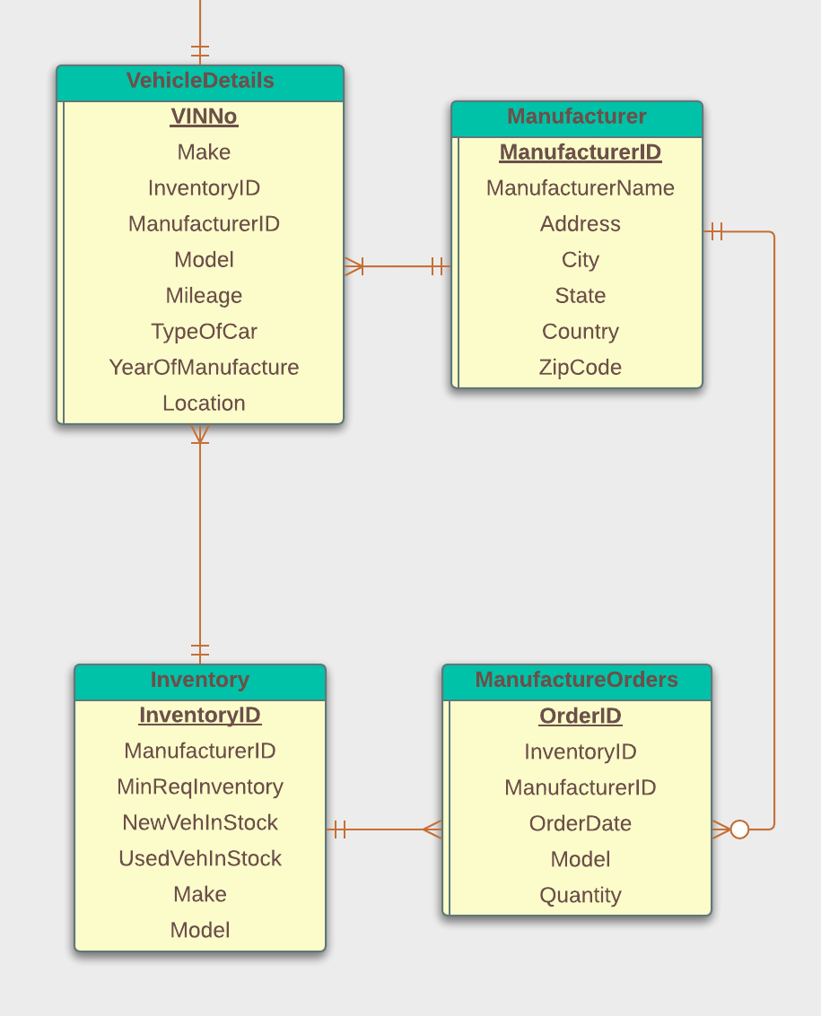
Each vehicle typically will be shipped from other manufacturers from multiple countries when the number of vehicles in inventory drops to a certain number.
InventoryID | ManufacturerID | Make | Model | MinReqInventory | VehInStock | Inventory Orders
101 | 1001 | GMC | Sierra | 5 | 2 | 3
102 | 1001 | GMC | Yukon | 5 | 2 | 3
103 | 1002 | Ford | Maverick | 5 | 3 | 2
104 | 1002 | Ford | Explorer | 5 | 1 | 4
105 | 1003 | Toyota | 4 Runner | 5 | 1 | 4
106 | 1003 | Toyota | Camry | 5 | 3 | 2
107 | 1004 | Chrysler | Chrysler300 | 5 | 1 | 4
108 | 1004 | Chrysler | Pacifica | 5 | 1 | 4
109 | 1005 | Honda | CRV | 5 | 4 | 1
110 | 1005 | Honda | ACCORD | 5 | 3 | 2
111 | 1006 | Dodge | Challenger | 5 | 4 | 1
112 | 1006 | Dodge | Charger | 5 | 6 | 0

Slide 10
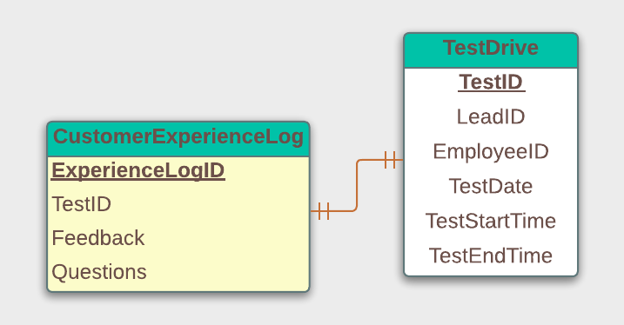
For each car test when the customer has problems or questions, the salesperson has to maintain a log. (Which has never been stored before in TAMUC systems digitally.)

Slide 11
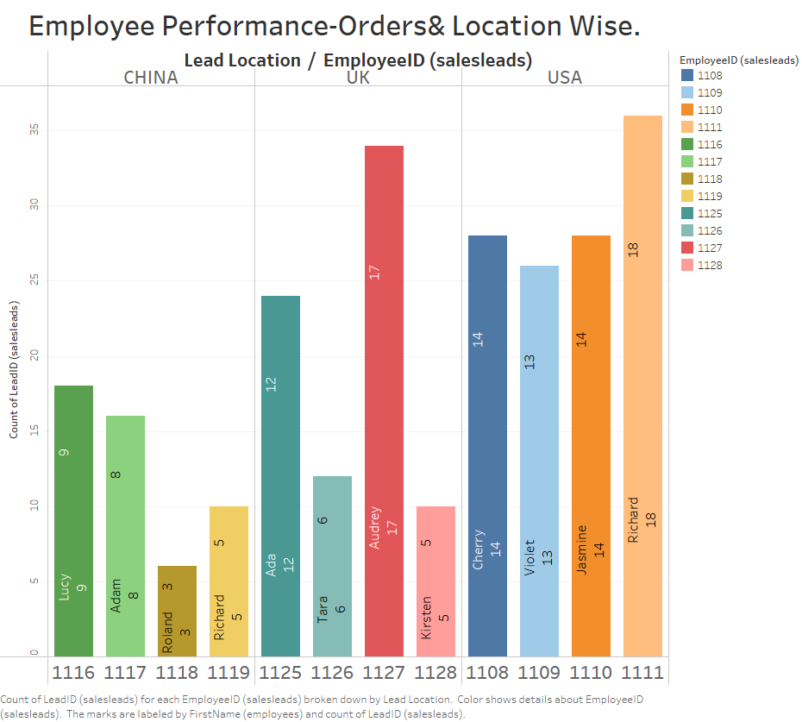

Slide 12
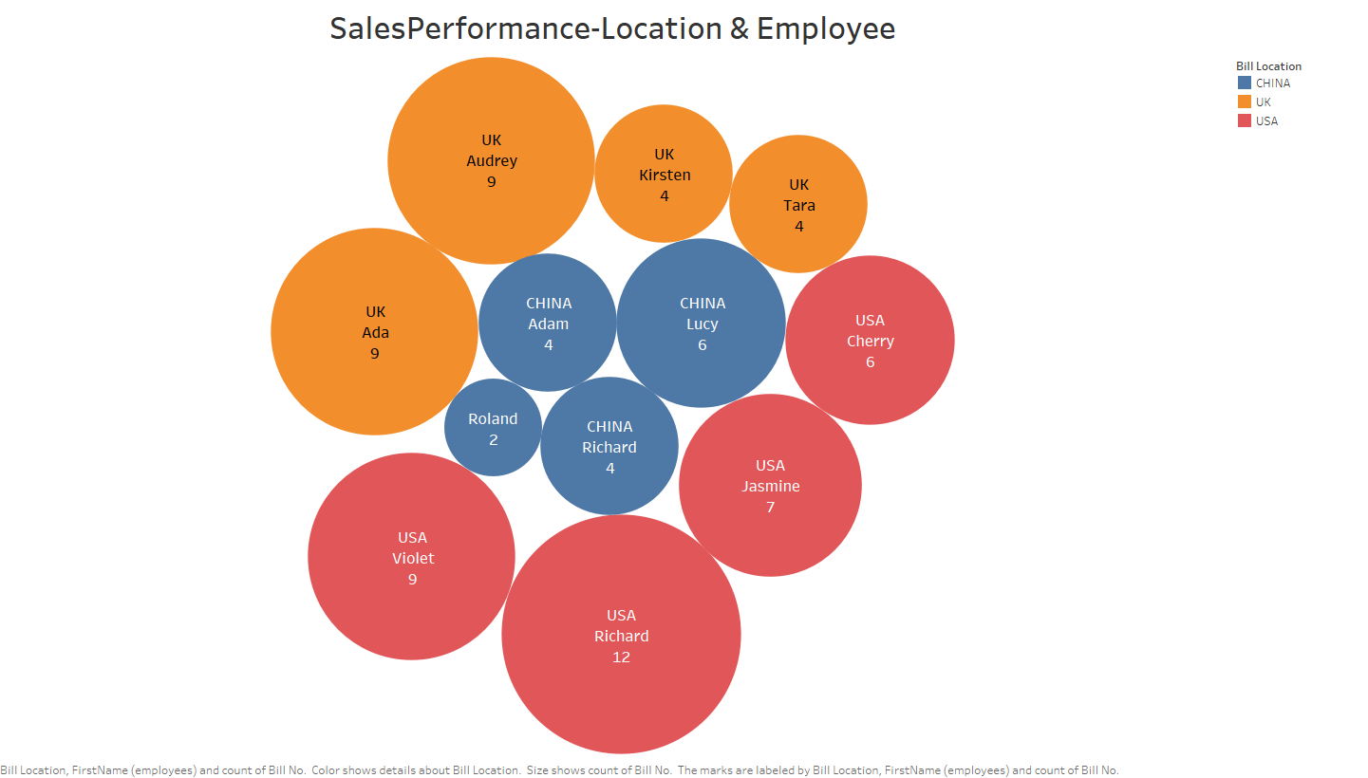

Slide 13
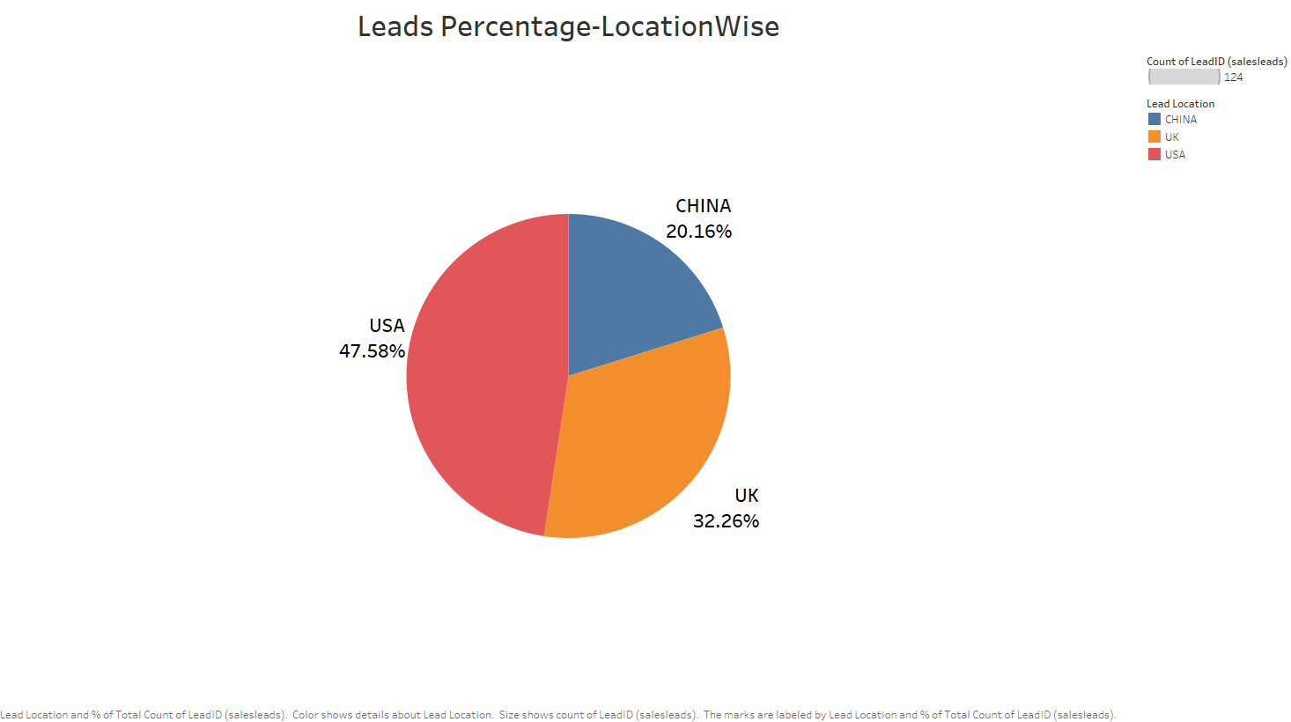

Slide 14
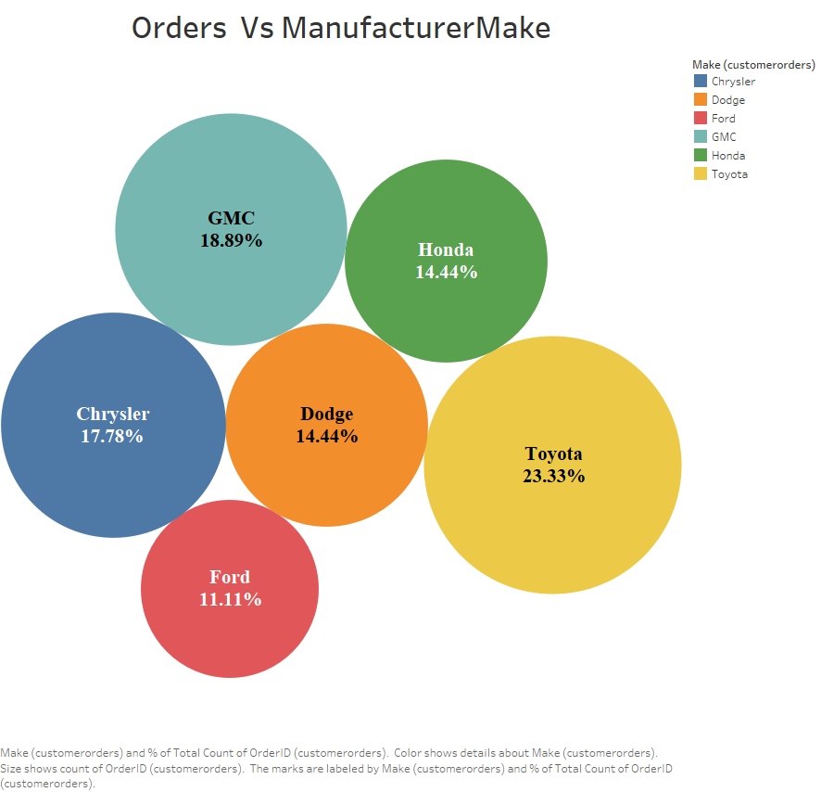

Slide 16
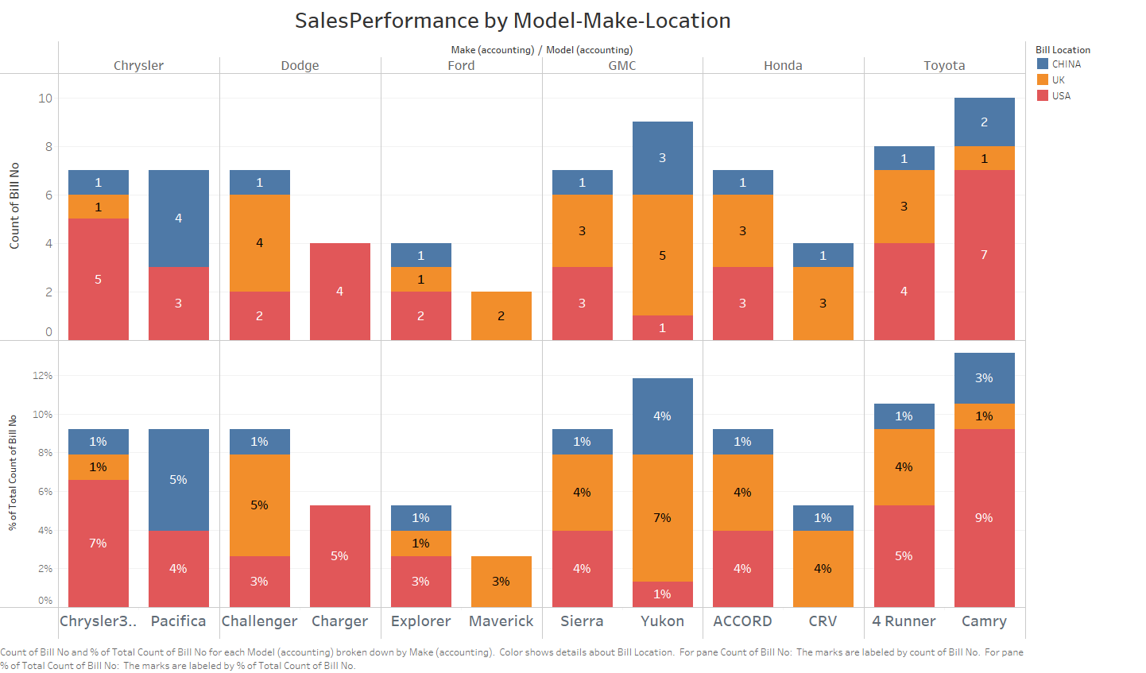

Slide 17
Thank You!

